Slide 1
is the acceleration engine to realize the full potential of and beyond.
S
S
a
a
5
G
Intelligent
Healthcare
Team 19
Notes:
Our world has changed a lot and our technologies continue to change as we speak. It is evident with evolving technologies we need to revisit the traditional business models and explore more effective and efficient business models. Today we are here to present a case for a business model which in our opinion is the business model of the future. SaaS.

Slide 2
S
a
a
S
?
Notes:
What is SaaS. It is a way of doing business. It is Software as a Service. Traditionally a company builds a software according to the user’s needs and sells the software to them and the user bares the responsibility of the software after the transaction.

Slide 3
S
S
oftware
a
a
ervice
s
Notes:
In SaaS, the company retains the ownership and the responsibility of the software and lets multiple users use the software by a subscription-based model. The SaaS business model is advantageous to both the company and the users.

Slide 4

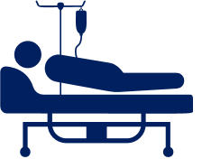
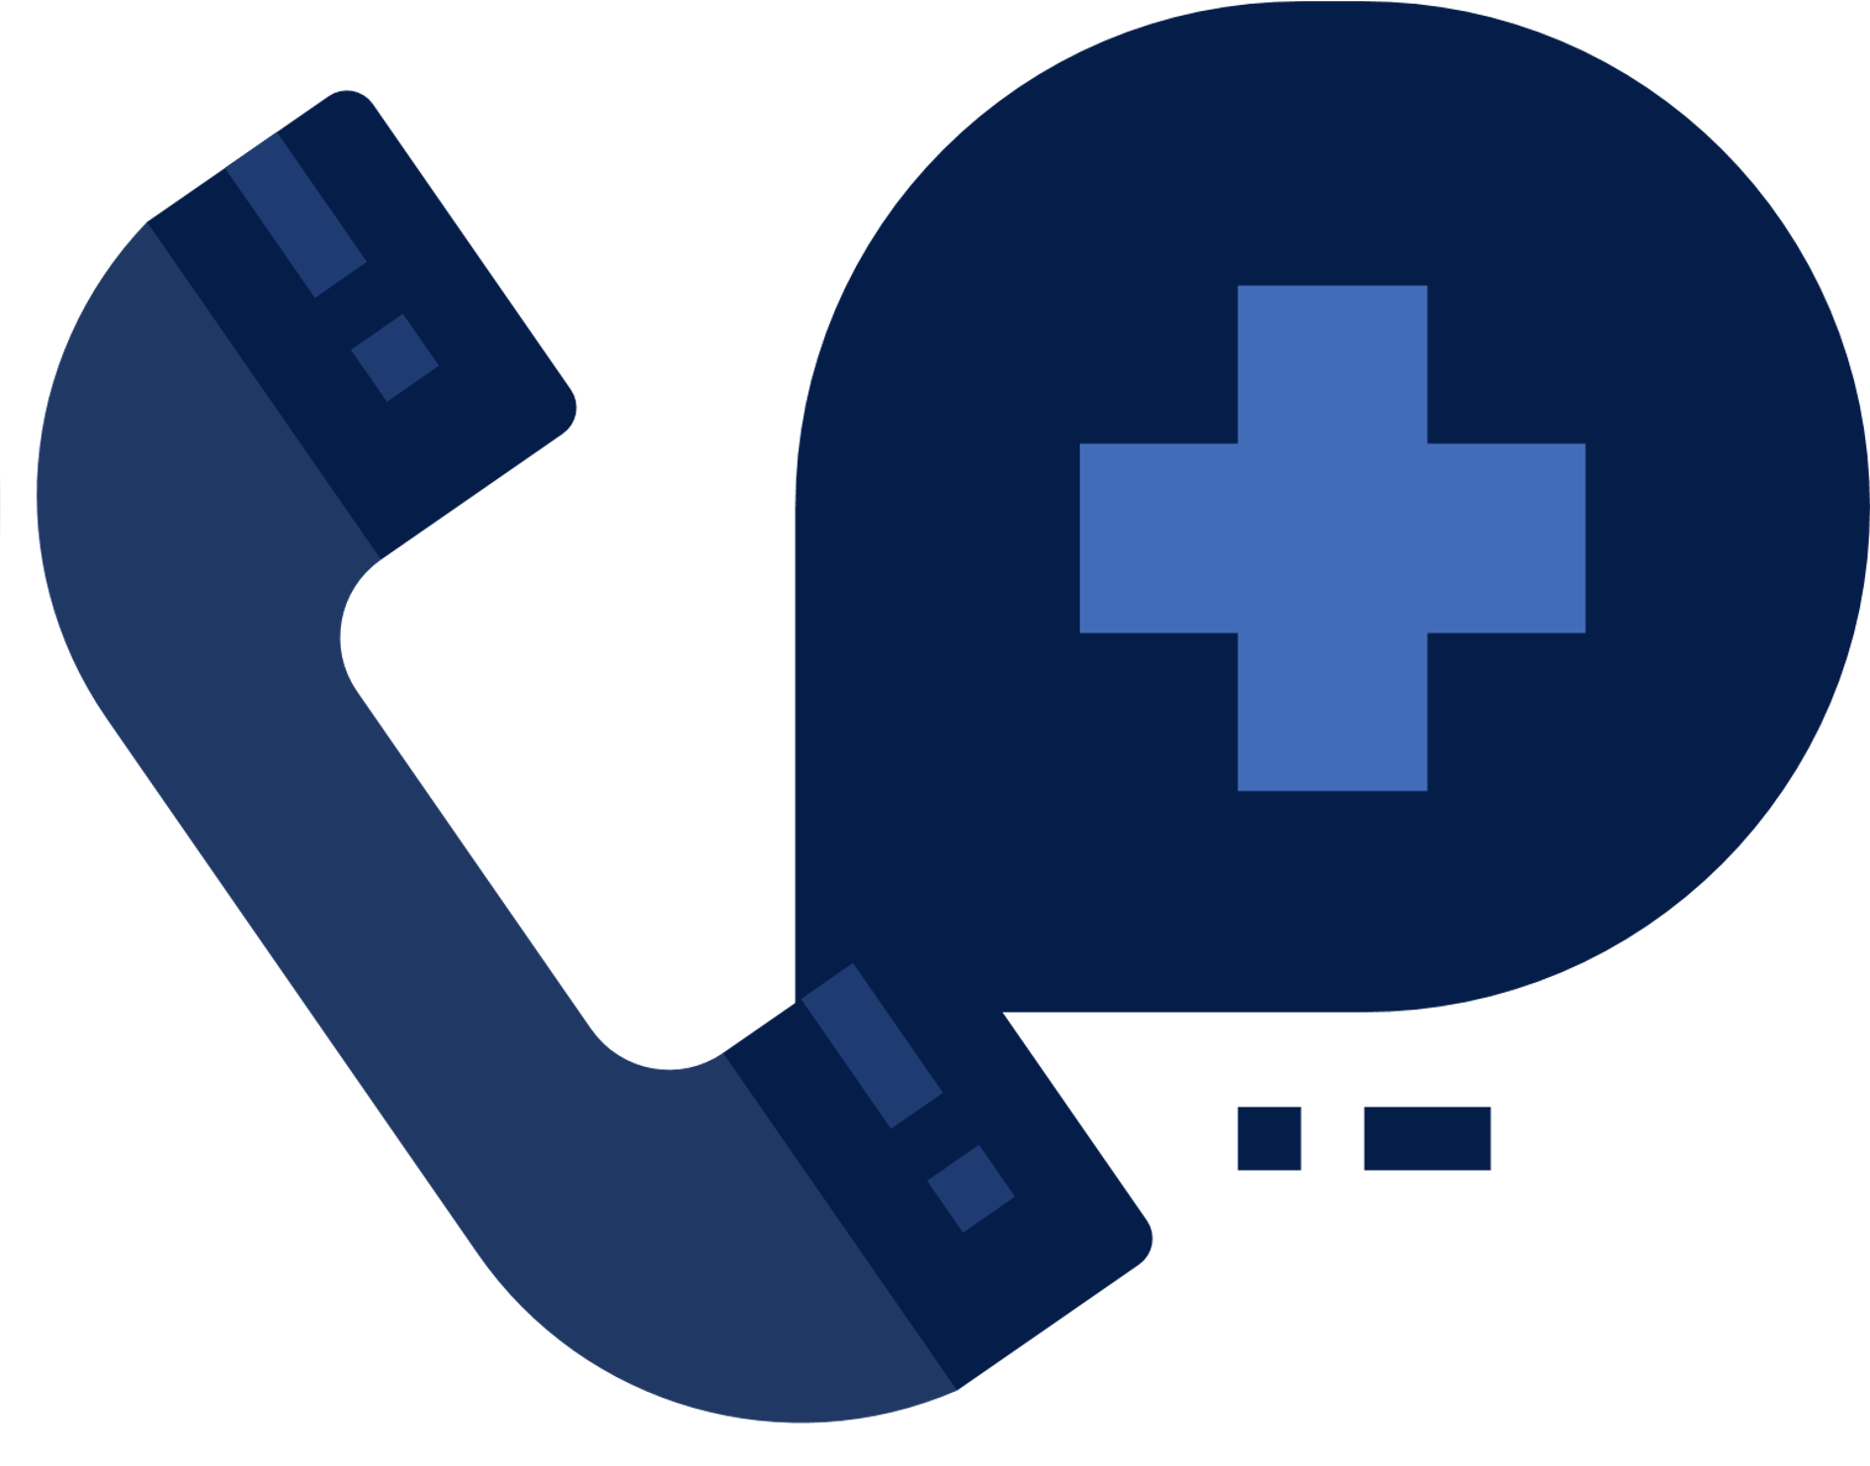
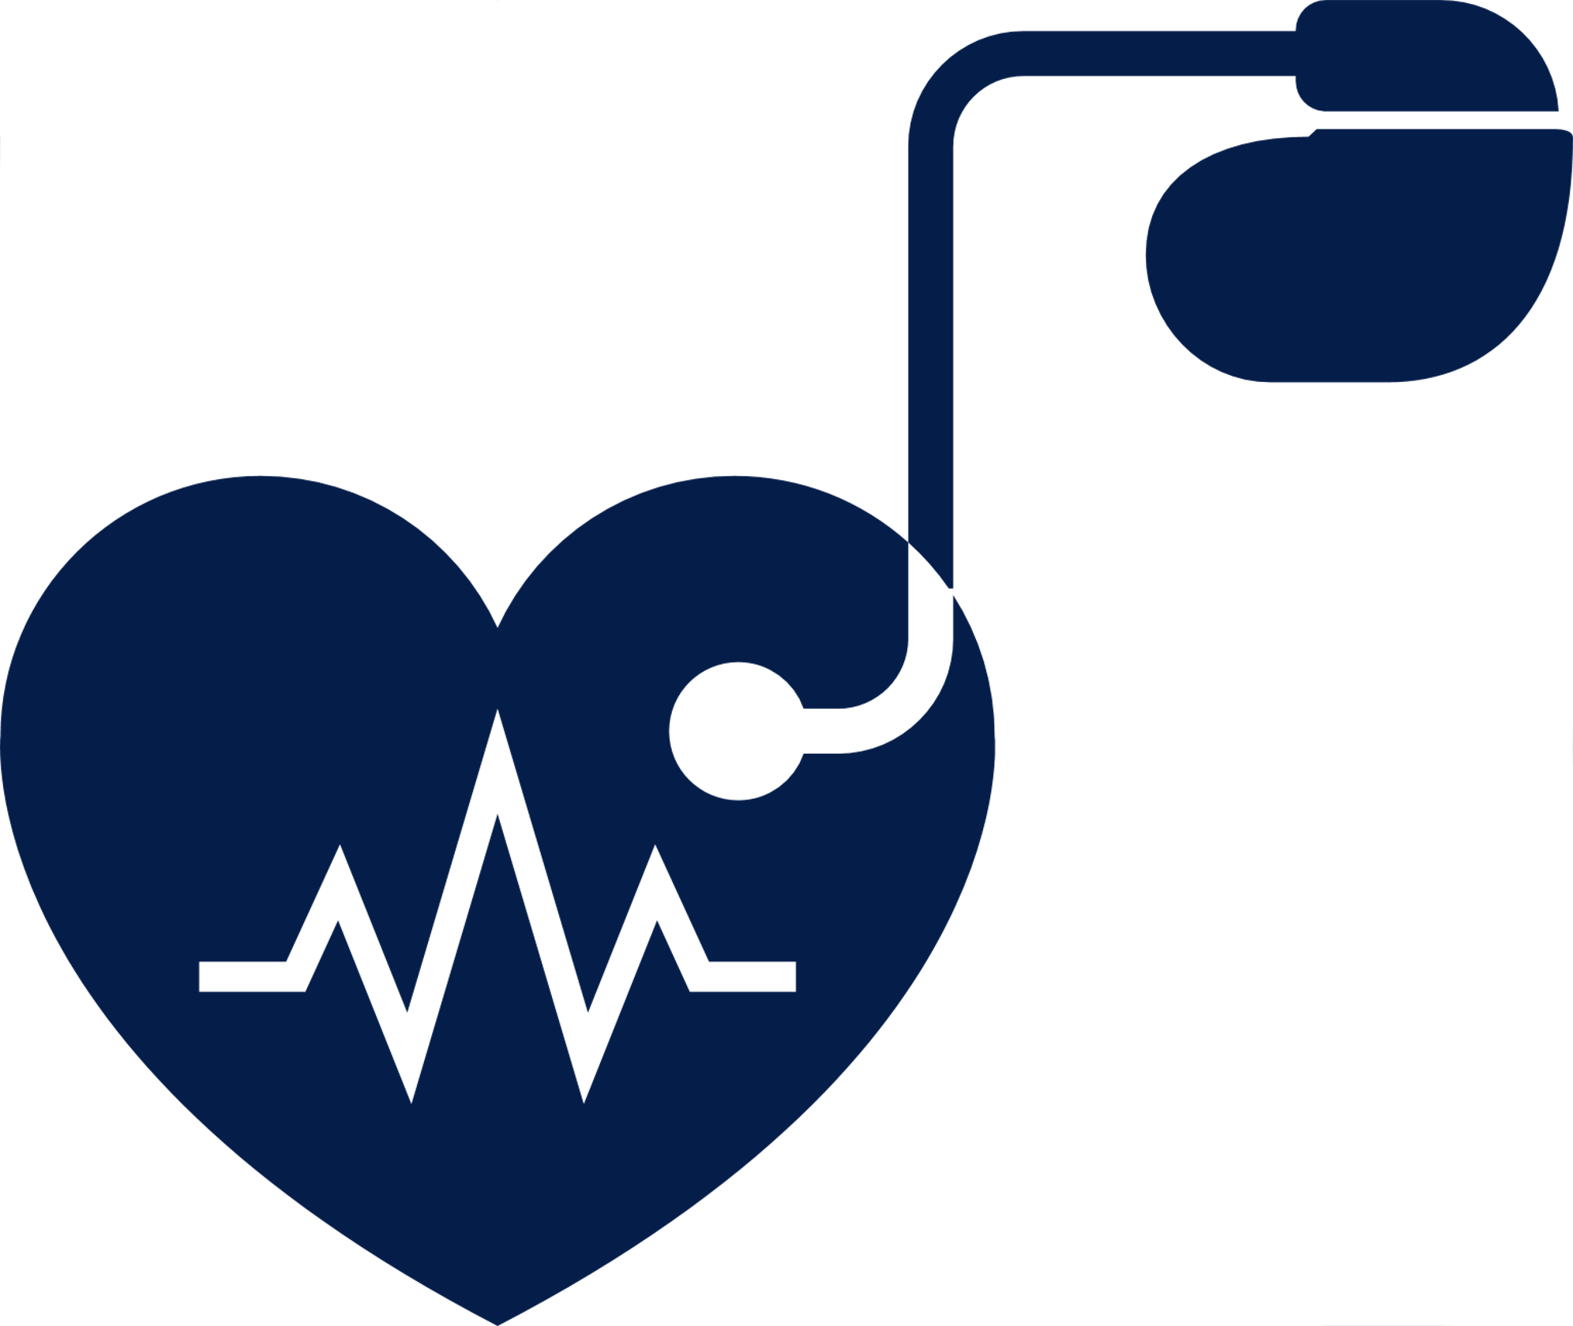


Healthcare
The problem with current
Understaffed hospitals
High bed occupancy
Lack of real time patient data
Delayed emergency response
Low access to remote monitoring
Disorganized patient data
Notes:
The pandemic has exposed the flaws in our current healthcare industry and its infrastructure. Some of the most prominent challenges the healthcare industry is facing are –
Unavailability of skilled workforce. Tee current healthcare industry is extremely understaffed, and it is proving extremely difficult for hospitals to manage day to day operations.
A chronic patient, let’s say someone who suffers from diabetes doesn’t get on time emergency response if something catastrophic happens with their health. There is no method of preempting a situation and alerting the emergency responders.
Currently it is difficult to monitor health of someone who lives in a relatively isolated area.
With the increase in sick population hospitals are facing immense strain of its infrastructure and have to turn away sick patients due to unavailability of beds.
A patient is usually kept under observation in a hospital room. Nurses cannot be at all the beds in the same time and thus miss out on critical real-time patient data.
Currently the data extracted from a patient is disorganized and usually cannot be leveraged later to further diagnosis.

Slide 5
Our Solution
SaaS Product to obtain real-time health parameters using the 5G-enabled devices
Collect, Store and Analyze patient wise data
Detect Anomalies in the patient’s health using Machine Learning
Notes:
Our Solution...
So.. what will we offer to address the existing issues in healthcare?
We will develop a SaaS product that will act as a medium for hospitals to monitor the patients.
So.. How does it work?
The hospitals will provide 5g enabled IoT devices to the patients sitting at the comfort of their homes.
Through constant communication, these devices will access the patient's real-time health data and transmit it to our product with 256-bit encryption.
Our product will collect, store and analyze the data using machine learning techniques and algorithms.
Our system detects anomalies through the pre-determined threshold limits we set for each medical parameter.
We can implement Artificial Intelligence in our product to give small effective measures directly without needing a healthcare provider.

Slide 6
Our Solution
Real-time dashboard displaying patient information to the healthcare providers
Critical Alerts to nearest emergency responders
Notes:
If the anomaly is on a critical level, our system alerts the nearby emergency responders, the hospitals, or a doctor sitting at his home.
We'll build a virtual dashboard with all the patient data displayed, which the hospitals and healthcare providers can access.
Sounds interesting... right?

Slide 7
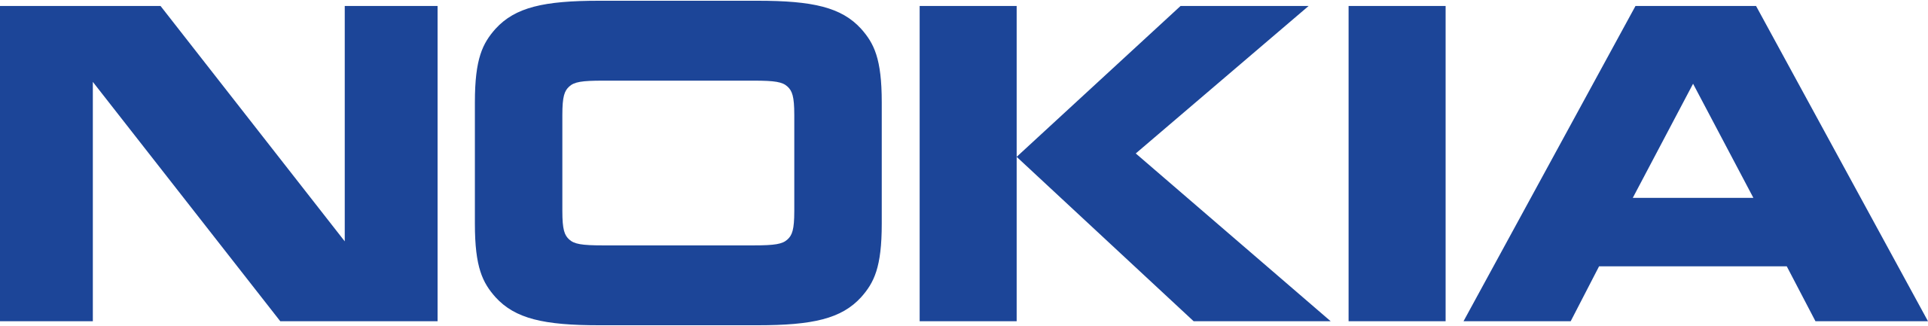
The Advantage
Patients
Fewer days in hospital
Increased selfcare
Healthcare professionals
Treat more patients
Higher quality of care
Remote healthcare
Advantages
Government
Healthier population
Increased insights for epidemiology
Hospitals
Higher patient throughput
Decreased wait-time
Notes:
Now let's see what the advantages of this model are
First, let's see how patients will benefit from this.
They need not stay in hospitals for a longer period for their post-surgery monitoring and save a lot of money by getting the same care.
Someone having diabetes or chronic disease can be diagnosed immediately after unforeseen circumstances
We'll know if their body behaves abnormally
Coming to healthcare professionals, They can oversee more patients at a time by monitoring them virtually
They can provide higher-quality care by monitoring the patient constantly.
And what's in it for hospitals?
They can provide higher patient throughput at a time.
They have less wait time as fewer patients visit the hospital.
Finally, we are going to help the government achieve
Healthier population
The government also has future insights into epidemiology.

Slide 8

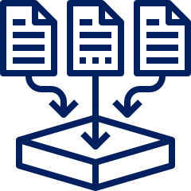
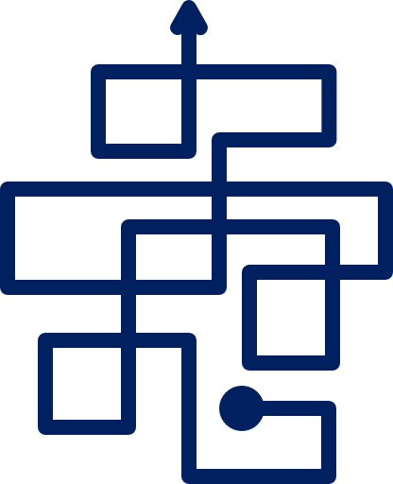

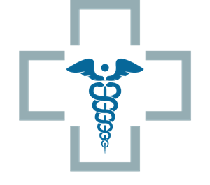
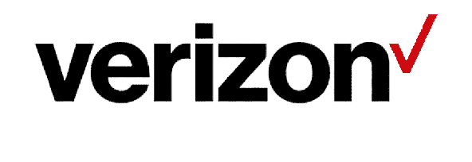
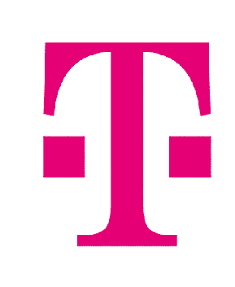
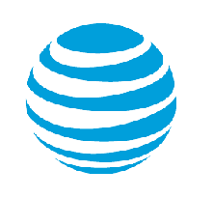


Business Model:
CSPs
SaaS Provider
Hospitals
Notes:
Next, how is this model going to work?
Consider Nokia is the company that develops the product.
We will create and manage this software which uses the 5G spectrum to interact with these devices
As we don't own the 5G spectrum, we will collaborate with various telecom companies to provide them with this software
The telecom companies will further collaborate with hospitals to deploy this software
We will retain the ownership of the software and provide the telecom industry with a subscription service based on the number of users

Slide 9
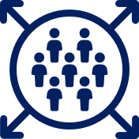

Why now?
Ultra Low Latency
High Capacity
Seamless Data Transfer
High reliability
Energy Efficiency

Slide 10
Why now?
Ultra Low Latency
High Capacity
In healthcare every second counts
5Gs ultra low latency makes it possible
Can support up to
1 Million devices per Sq. Kilometer
Prevent Remote complications
Seamless Data Transfer
High reliability
Notes:
So, the big question... WHY NOW?
When we are talking about healthcare, each second counts. Until now we had 4g which has high latency in transmission.
But with the invention of 5G, we have ultra low latency which can transfer data under 5ms.
Also a single person can have many sensors and when you consider a city or a county there can be more than 10 million devices which need to be
connected at a time which cannot be done on 4g. Only 5g can support this.

Slide 11
Why now?
High volume
Data Transfer
Energy
Efficiency
High
Reliability
Medical devices produce massive amounts of data
5G has high bandwidth
99.99% Reliable Network
Highly efficient
IoT Devices
Notes:
Each patient generates a lot of data that needs to be transmitted to the hospital, 5g supports high bandwidth and can transmit huge amounts of data.
When we talk about reliability, 5g is as reliable as a wired connection . There are no data or network drop issues.
Finally, the 5g powered IoT devices are 90% more efficient when compared with its predecessor, 4g, due to improvements in small cells, spectrum efficiency, and Multiple Input and Multiple Output devices.

Slide 12

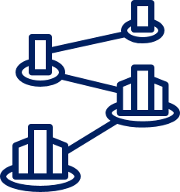



The SaaS-ification
Finance
Scalability
Maintenance
Upgradability
Pay as you go
Low initial costs
High financial benefits
Increased usage of the 5G spectrum
Notes:
Now we have seen why now the right time is for advancing remote healthcare. Now let’s see how the SaaS model accelerates it.

Slide 13


The SaaS-ification
Finance
Traditional
High initial investment
Own data storage solutions
SaaS
Low Initial investment
Data storage in our scope
Notes:
Financial impact
Let us assume we go with the traditional route –
The CSPs will have to cough up huge sums of money to buy the whole software. The CSPs will not make a single penny until the software is developed and deployed.
In the SaaS model, the initial costs will be taken up by the SaaS provider.
5G enables us to send and receive massive amounts of data, in the traditional model storing this data will add a huge cost the the CSPs whereas in the SaaS model the data storing costs will be the SaaS providers responsibility.

Slide 14
The SaaS-ification
Scalability
Traditional
Designed for finite users
Redesigning
SaaS
Infinitely Scalable
Expand customer base
Notes:
More and more devices are becoming 5G compatible and this will keep on growing. The remote monitoring software needs to be scalable as the CSPs will want to grow the business. Traditionally a software is built for a finite number of users and warrants a complete redesign to accommodate higher number of users.
In the SaaS model, there is no limit on the number of possible users and the CSPs can grow their business as big as possible. This scalability not only helps CSPs reach more customers but also enables the SaaS provider to expand to new markets. For example, AT&T can keep on incorporating more hospitals in this software and a SaaS provider can expand to different countries using the same software but a different CSP.

Slide 15

The SaaS-ification
Maintenance
Traditional
In-house team
Delayed resolution
SaaS
Highly efficient centralized team
Quick resolution
Notes:
Traditionally a software once sold would become the responsibility of the CSP. Which means the CSPs will have to hire expensive and exhaustive teams to not only maintain this software but to also address customer queries. Which will be a massive undertaking for the CSPs.
In the SaaS model the SaaS provider will retain the ownership which means the responsibility of maintaining the critical software lies with the SaaS provider. This is also beneficial for the provider as it will have a high functioning centralized team which will be catering to a huge customer number base making it extremely profitable.

Slide 16

The SaaS-ification
Upgradability
Traditional
Difficult to upgrade
High-costs
SaaS
Continuous upgradation
Relevancy
Notes:
5G represents a step in the technological evolution and 6G and more are around the corner. It is impossible to incorporate newer technologies in softwares sold in the traditional model as the will hhave to be rebuilt from scratch.
In the SaaS model the provider has an incentive to keep on incrementally upgrading the software which will ensure the software stays relevant for years to come.

Slide 17


Thank You!
Notes:
In Conclusion
The benefits of SaaS perfectly align with the advantages offered by 5G and can accelerate the use of 5G greatly.

Slide 18
Team
Parth Kulkarni
Hemantab Reddy Battula
Ishwari Milind Gondkar
Sudeeksha Golla
Krishna Bezawada

